Slide 1
Precious Mirror
Translating the Calligraphy of
Kobun Chino Otogawa

Slide 2
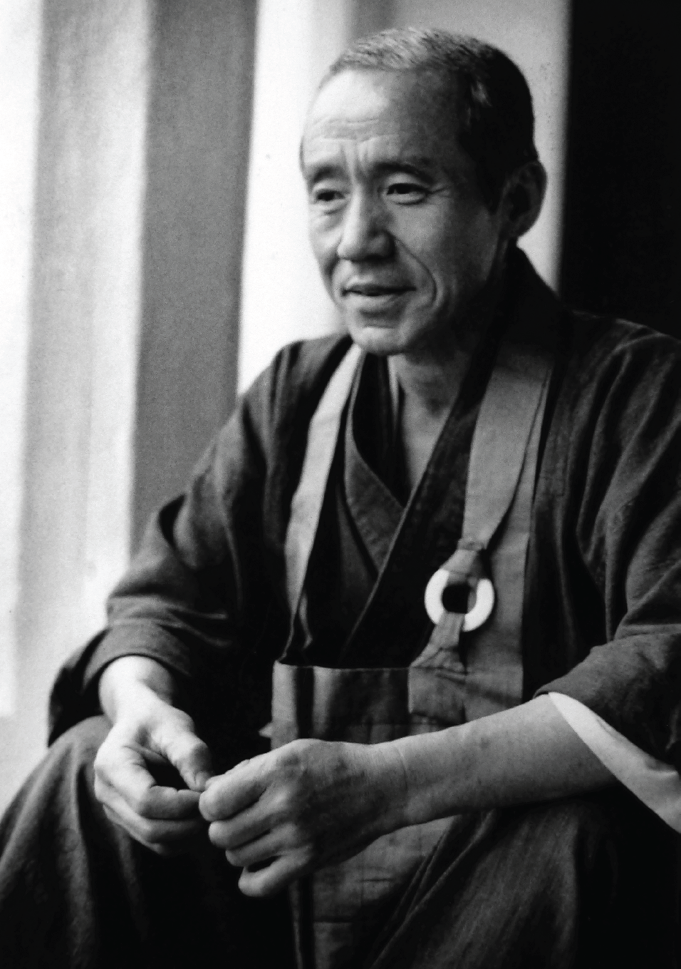
Kobun Chino Otogawa, 1938 - 2002

Slide 3
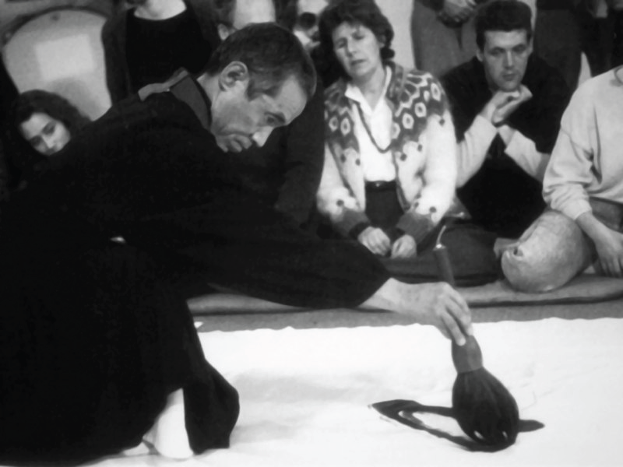

Slide 4
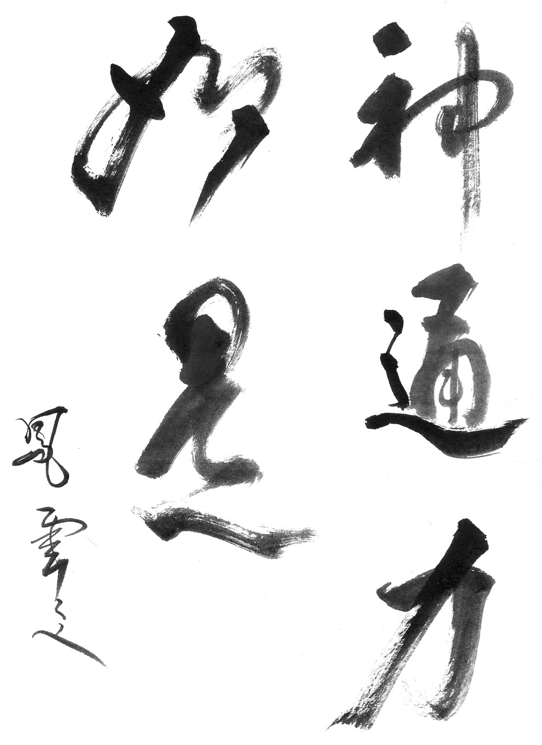
If you want to see
the power of the spirit,
it’s right in front of you.

Slide 5
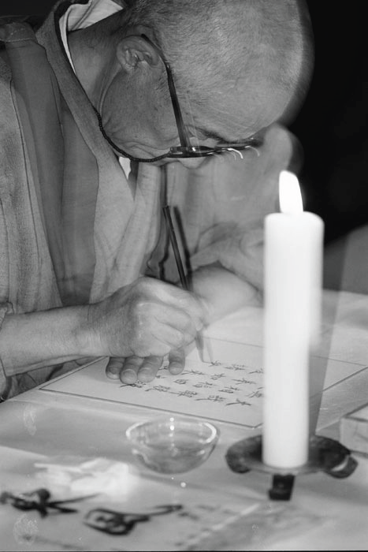

Slide 6
HO-KYO ZAN-MAI
宝 鏡 三 昧
Treasure-Mirror Samadhi
Nyoze no hō,
1 如是之法。( 如是の法。)
The Law [Dharma] of such-ness [Tathagata],
Busso mitsu ni fusu,
2 仏祖密附。( 仏祖密に附す。)
Buddha ancestors intimately handed [it] down.
Translation and syntax of the Chinese Kanji was made by Graham Healey,
Dept. East Asian Studies at the University of Sheffield (U.K),
and Shindo Gensho (Richard Jones), ArrivingHome, Sheffield (U.K).
(Hôkyô zanmai)
Precious Mirror Samadhi
The dharma of thusness
is intimately transmitted by buddhas and ancestors.
Translation from Soto School Scriptures for Daily Services and Practice
The law (Law) (Dharma) of thusness/suchness (such as it is)
Thus/Such is the law
Whatever is—is.
That’s really the only law.
or
The truth can be found
in this world.

Slide 7
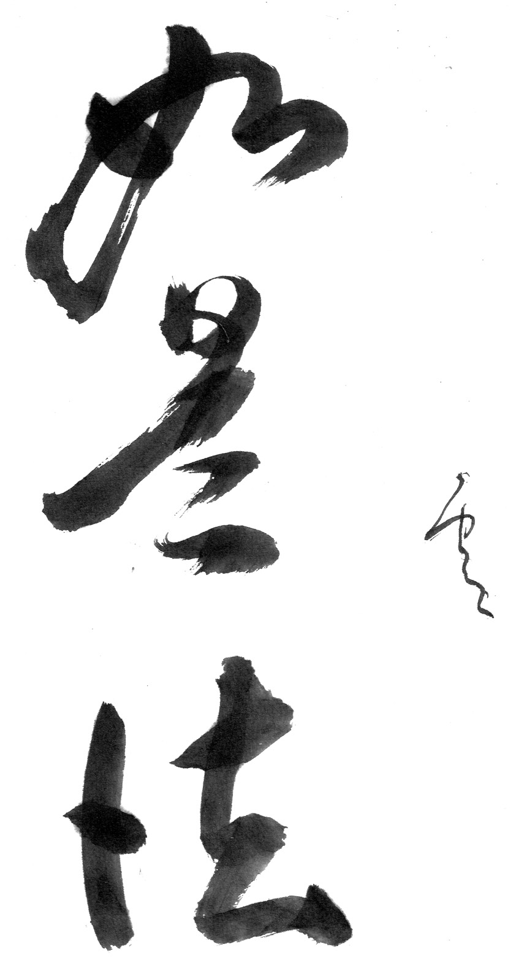
Whatever is—is.
That’s really the only law.

Slide 8
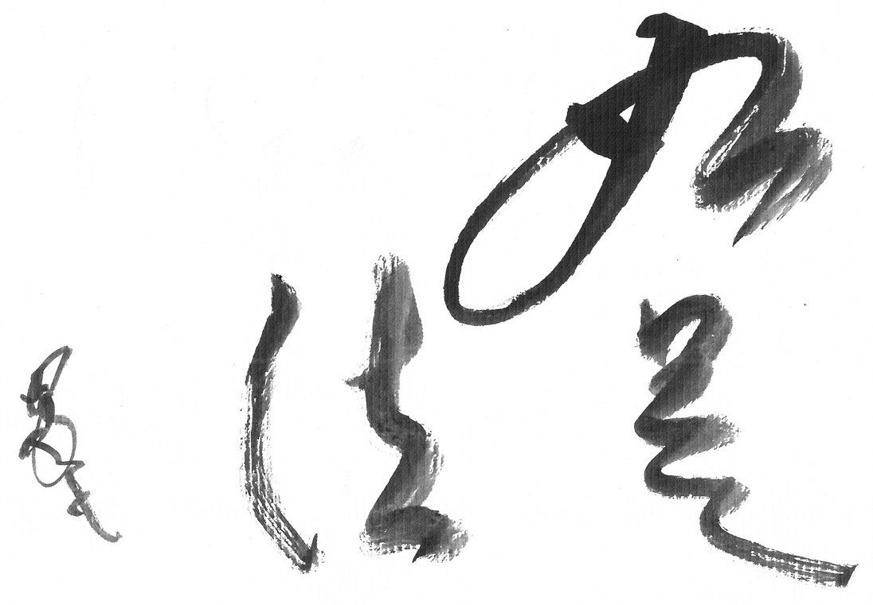
The truth can be found
in this world.

Slide 9
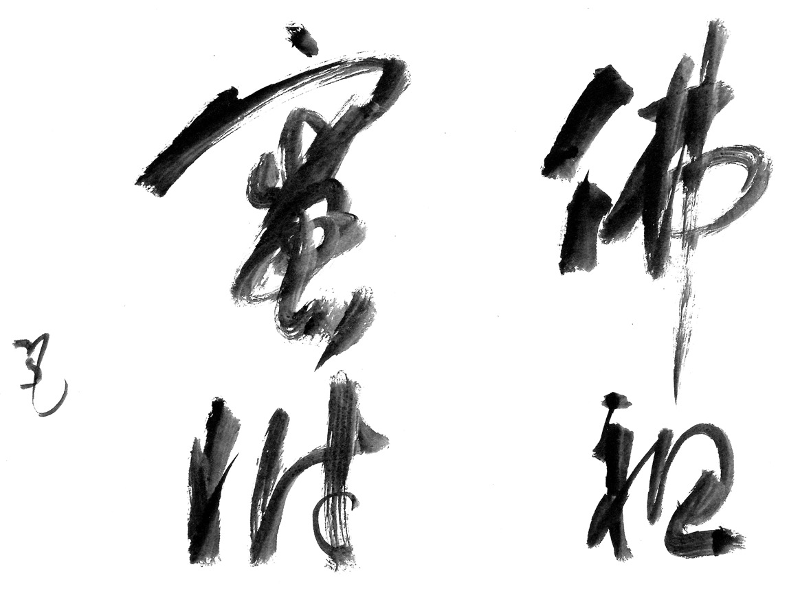
Buddha’s intimate secret
has been handed down
from one to another
since the beginning.

Slide 10
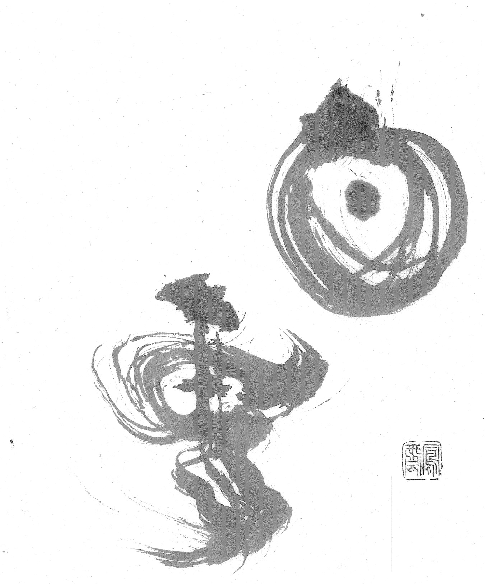
The white cloud
reflected in a mirror
cannot speak.

Slide 11
“haku un” = “white cloud”
Like so many pieces of Kobun’s calligraphy, this piece makes reference to the title of Ho-kyo Zan-mai — “Treasure Mirror,” or “Precious Mirror.” The character for “cloud” has been written in mirror writing, but it’s intentional, as the stamp is on the right face.
The character for “white,” which can also denote “nothing,” has a dot in it, and so is not meant to be spoken.
In a lecture, Kobun talked about the master and his student being mirror
images of each other. He later said:
“You follow the stream to where it disappears, and you and the teacher see each other. You say, ‘You are my origin,’ and he says, ‘You are my origin.’”
I took liberties with the two characters by merging their literal meanings with their context in the Ho-kyo Zan-mai, with the visual pun of the mirror writing, and with my knowledge of Kobun’s philosophy to arrive at the final translation:
The white cloud
reflected in the mirror
cannot speak.

Slide 12
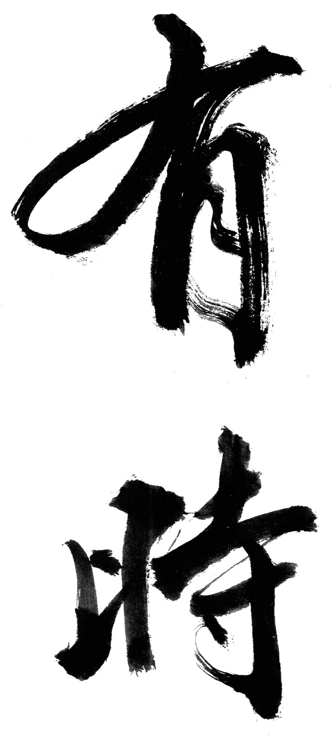
The only time you have
is now.

Slide 13
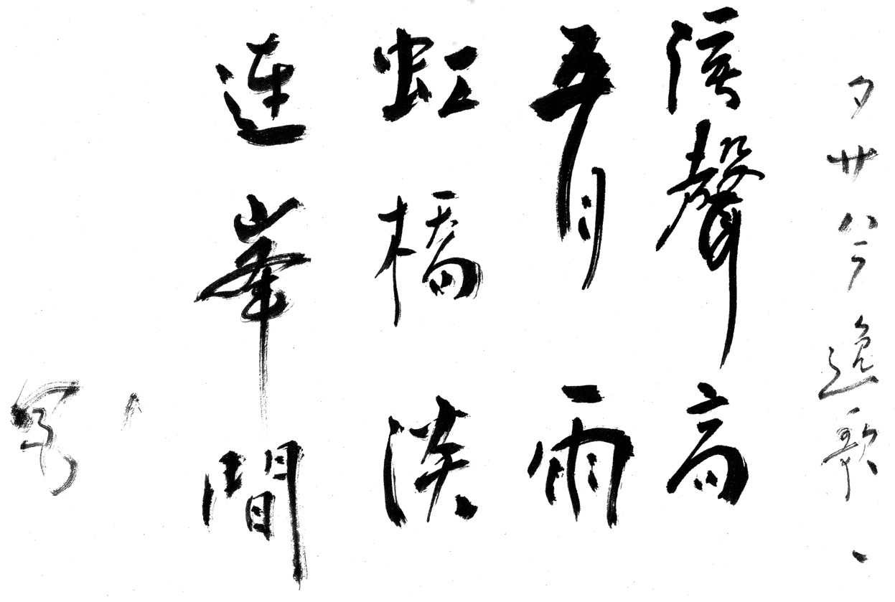
During the rainy season,
the little stream became
a roaring torrent,
and a rainbow appeared
like a bridge across the mountains.

Slide 14
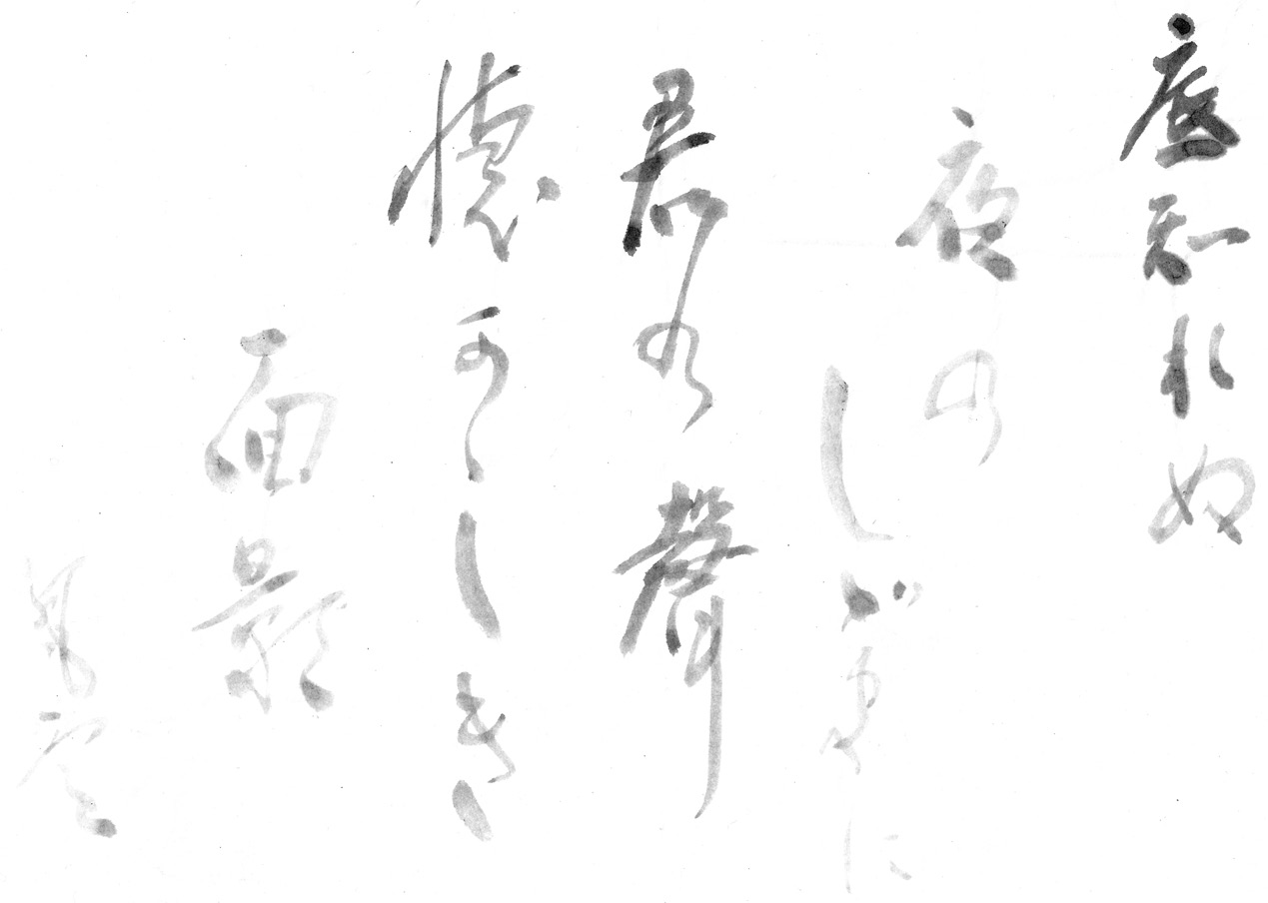
Late at night
I remember your face,
and in the dark,
I think I hear your voice.

Slide 15
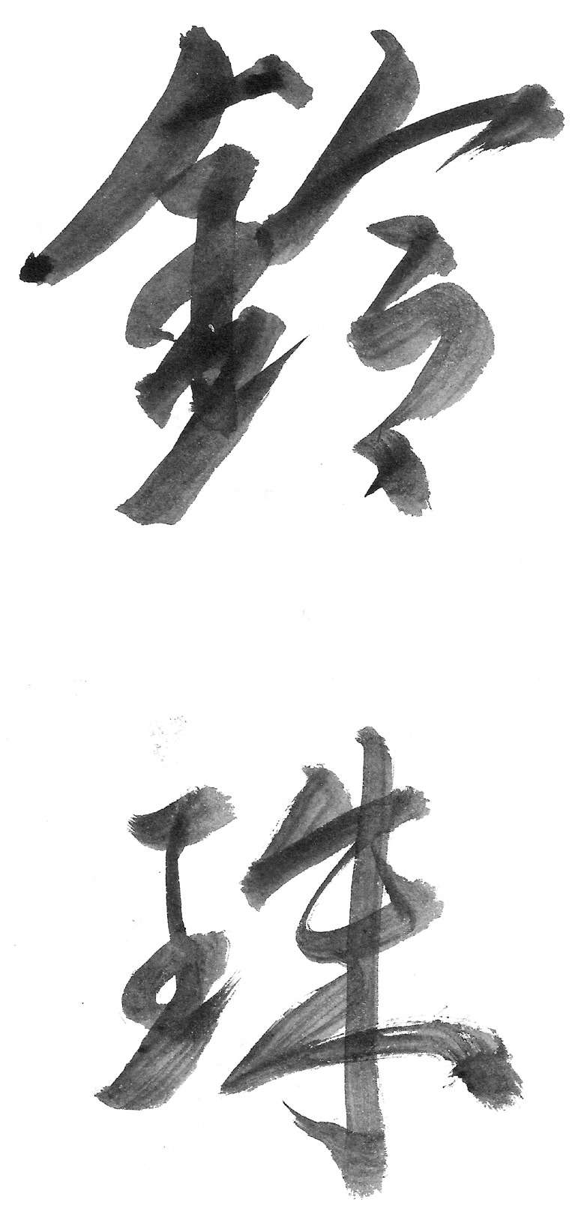
You are a bell
made of jade.

Slide 16
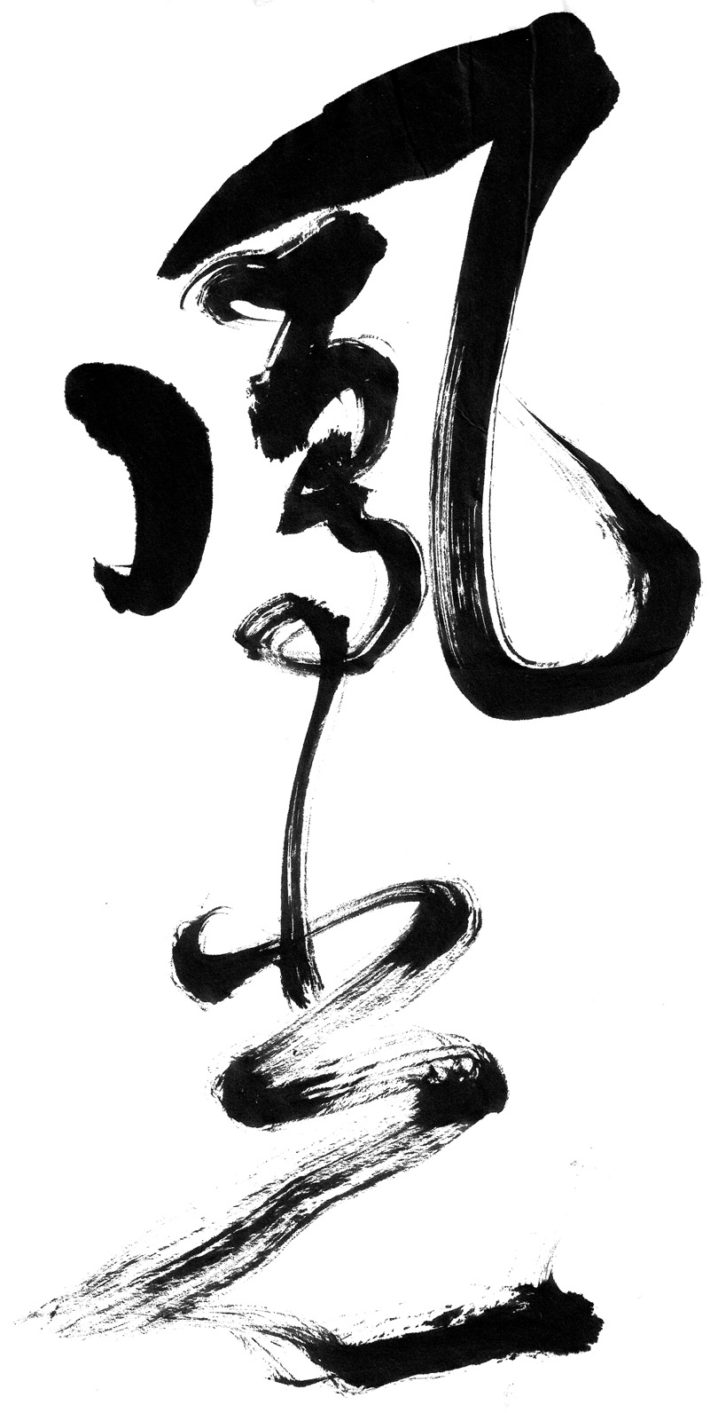
No matter where I look,
it’s beautiful.

